Slide 1
Trend in SDSGC
Jordan Kim
jordankim209@gmail.com
Notes:
Please enter project details and your details here.

Slide 2
A bit about yourself ☺
UoA - BSc in Data Science (3rd year)
Interest/Hobbies: Programming/games
Best part of MSA: Practical experience
Future Goals: Working in the field of Machine Learning
Notes:
This section is NOT assessed. We just want to get to know you ☺.

Slide 3
The Problem
SDSGC – Gacha Game
Are people liking the game? (Look at trend of 1 week)
Notes:
User Experience

Slide 4
Data Extraction and Cleaning
Used Reddit API to obtain top 200 hottest posts
Cleaning Data:
Removed links, lowercase and newline characters, etc.
Removed time to only display the dates
Notes:
Talk about your database, what schema you used and what data you used

Slide 5
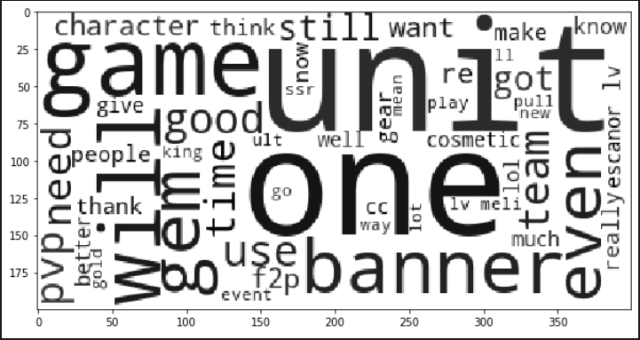

Data Exploration
Bigram
WordCloud
Notes:
Advanced features…

Slide 6
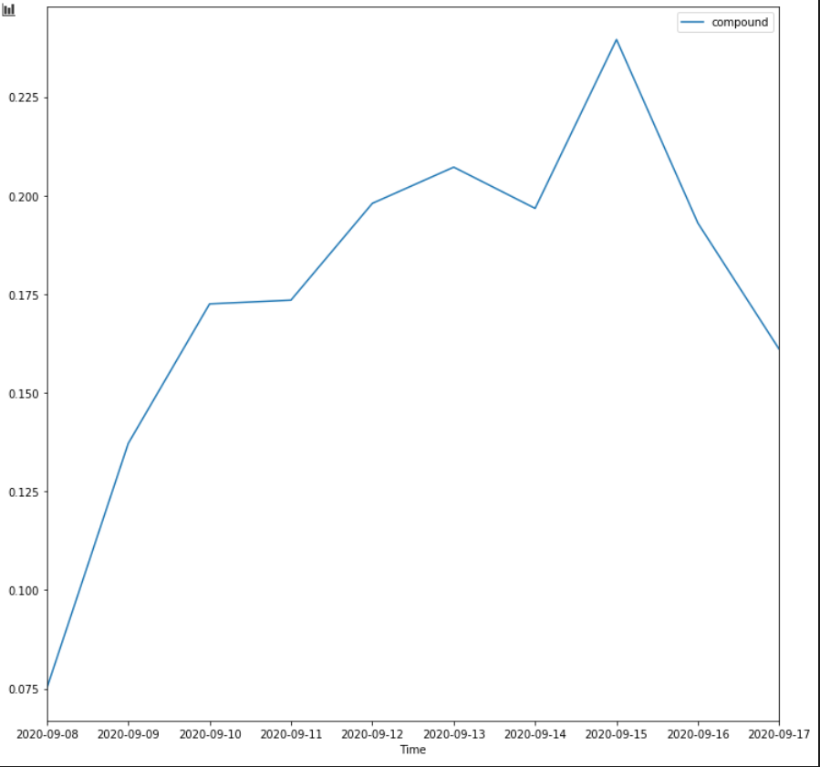
Sentiment Analysis
Notes:
Explain your Azure features here

Slide 7
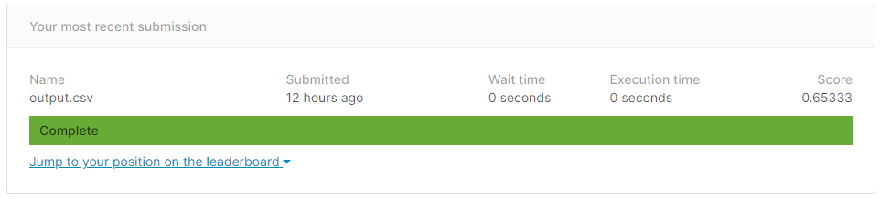
Kaggle Challenge
Attempted with tensorflow
Cleaned the data but couldn’t get it to work
Restarted using Naive Bayes classifier
Removed links, tokenized, lower, stop words
Notes:
Advanced features…

Slide 8
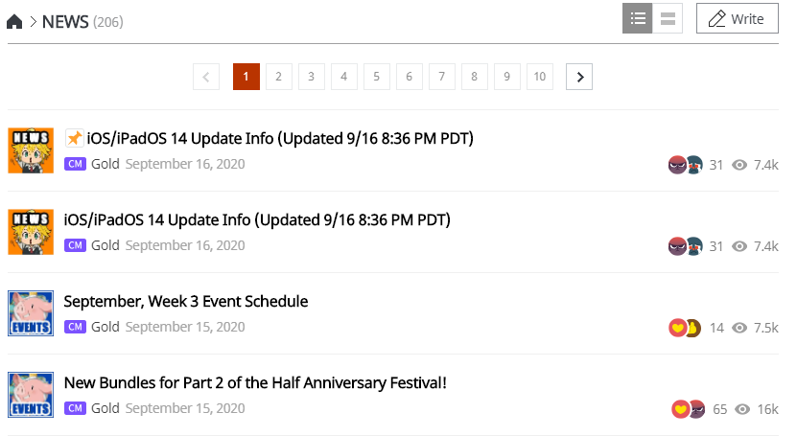
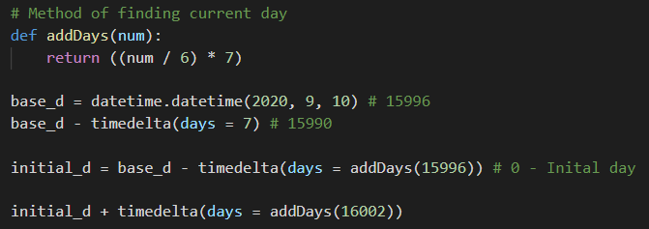

Advanced Requirement
Scraped Netmarble official forums
Using requests
Had a weird date format
Extracted the percentage of positive reactions
Notes:
Advanced considerations…

Slide 9
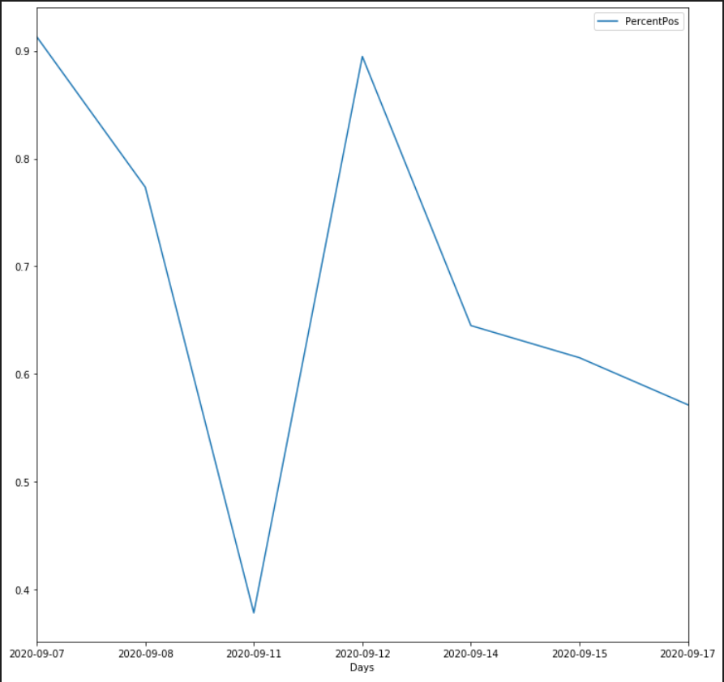
Reddit Forums

Slide 10
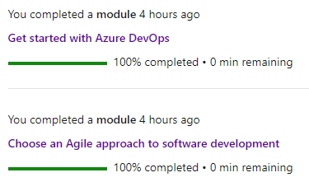
Final Comments
Thanks for listening to my presentation and giving me this opportunity once again!
Notes:
Any final things you want to tell us

